Slide 1
Chapter “2”
History of management

Slide 2
Overview
The concept of management has been around for thousands of years.
Management history utilizes the tools and methods of traditional historical analysis as well as drawing insights from business disciplines and the social sciences.
Understanding the evolution of management thought is important as it helps determine what management principles and practices work best for your team and your organization. It can help you manage your team and workplace more effectively.

Slide 3
Evolution of management
Ancient ages:
the process of “getting work done through people.” Studying management in the ancient world presents unique problems. The boundaries between public and private sectors are often highly fluid, and exchanges often took place for motives other than profit.
“Management” in the context of Antiquity may be defined as the organization and supervision of production, and as exchange in agriculture, manufacturing, and/or services such as public administration of taxation systems or treasury

Slide 4
Evolution of management
Industrial revolution:
Prior to the Industrial Revolution, goods and services lacked standardization and were produced at home in small batches. The Industrial Revolution saw work shift from family-led home production to factory production.
With the invention of the steam engine, numerous innovations occurred, including the automated movement of coal from underground mines, powering factories that now mass-produced goods, and railroad trains that could move products and materials across nations in a timely and efficient manner.
As these facilities became more substantial and productive, the need for managing and coordination became an essential factor.

Slide 5
Overview
The Modern Era:
Management by Objective (MBO) is the process of defining specific objectives necessary to achieve the organization’s goals.
MBO concept provided employees a clear view of their organization’s objectives and defined their individual responsibilities.
The role of management is now to support, monitor, and evaluate performance. Should a problem arise, it is management’s responsibility to take corrective action.
This MBO cycle applies to every department within an organization, large or small, and never-ending.

Slide 6
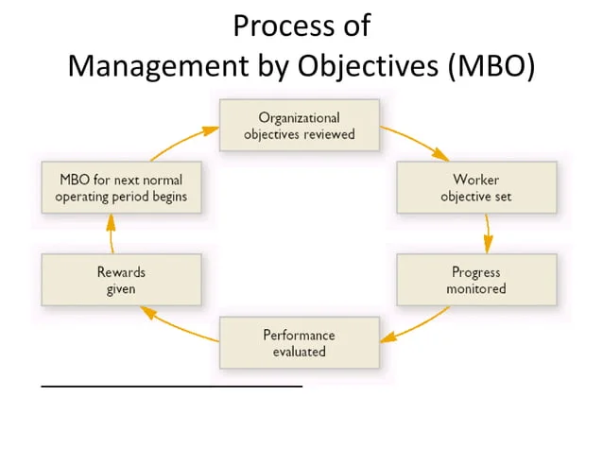
Overview

Slide 7
Management theories
Management theories help organizations to focus, communicate, and evolve. Using management theory in the workplace allows leadership to focus on their main goals.
By understanding management theory, basic assumptions about management styles and goals can be assumed and can save time during daily interactions and meetings within an organization.
While some theories can stand the test of time, other theories may grow to be irrelevant and new theories will develop in their place.
While the Industrial Revolution sparked these new theories, even more innovation came in the decades that followed as companies changed to adapt to business needs.

Slide 8
Management theories
1- Scientific Management Theory
Frederick Winslow Taylor developed and published his Scientific Management Theory in 1909.
Believes that it is vital to find the most effective way to complete each and every task, no matter how small.
Task should be completed as efficiently as possible and everyone should be assigned a particular job based on their skills and abilities and must be evaluated based on the quantity and quality of their work.
It was extremely important to monitor and train your employees on the tasks they are assigned to. By ensuring your employees are efficient at their work, the output will be larger and of a higher quality.
This theory had a huge impact on the way companies operated and how they were able to create a more balanced pay system, better training, and a more efficient workforce.

Slide 9
Management theories
2-Administrative Management Theory
Administrative management theory was developed by Henri Fayol in the early 1900s
Considered to be highly relevant even today. Fayol created fourteen principles which he believed outlined the basis for strong and successful companies.
Focused on the process of completing the work most effectively and also focused on the organizational structure of a company as a whole.
It is the idea that everyone in a company should be aligned by organizational goals.

Slide 10
Management theories
3- Bureaucratic Management Theory
Max Weber created the bureaucratic management theory in 1921.
Weber believed efficiency in completing tasks was a key component to success and recommended detailed record keeping at all levels to monitor efficiency as well as areas of opportunity.
The increased use of technology could have a negative impact on a company’s culture. Too much change can be harmful to company morale and create long lasting negative effects on company success
leaders are viewed in a negative light while managers are appreciated and recognized.
To ensure the safety and longevity of a company’s culture, Weber believed hiring employees based on their personality was critical.

Slide 11
Management in the 21st century
Managers in the 21st century must confront challenges their counterparts of even a few years ago could hardly imagine.
The ever-growing wave of technology, the impact of artificial intelligence, the evolving nature of globalization are chief among the demands today’s managers will face.

Slide 12
Management in the 21st century
Technology:
Management today has to deal with the explosion of data now available to facilitate business decisions.
Collecting, organizing, utilizing data in a logical, timely, and cost-effective manner is creating an entirely new pattern of managerial competence.
Each of these opportunities requires a new degree of managerial competence which, in turn, creates opportunities for the modern-day manager.

Slide 13
Management in the 21st century
Artificial Intelligence
Will robots replace workers? To be sure, this has already happened to some degree in many industries.
AI has the ability to eliminate ordinary tasks and free managers to focus on the core of their job.
Human skills such as empathy, teaching and coaching employees, focusing on people development and freeing time for creative thinking will become increasingly important as AI continues to develop as a critically important tool for today’s manager.

Slide 14
Management in the 21st century
Globalization
Globalization has been defined as the interdependence of the world’s economies and has been on a steady march forward since the end of World War II.
Managing in the era of globalization brought a new set of challenges (new cultures, different laws, import/export regulations, logistics, currency, government intervention ….etc.) are among the demands facing the 21st century global manager.
Despite these enormous challenges, trade among the world’s nations has grown at an unprecedented rate.
World trade jumped from around 20% of world GDP (Gross Domestic Product) in 1960 to almost 60% in 2017.

